Slide 1







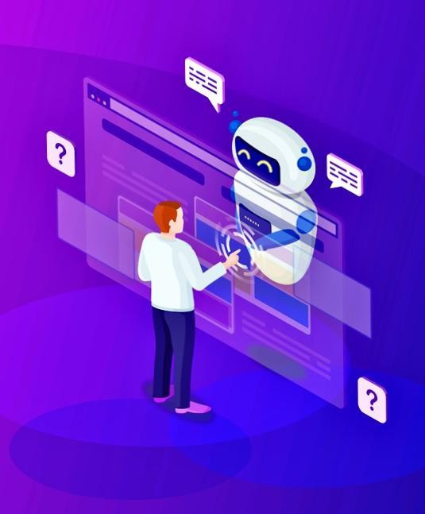




AICustomer service CHATBOT
A PRESENTATION BY:
POOLA JOSHIKA [ENG22AM0120]
KOMMURI VENKATA SAI ABINAY [ENG22AM0108]
JANET MATILDA JOHN [ENG22AM0099]
KISHAN C [ENG22AM0107]

Slide 2
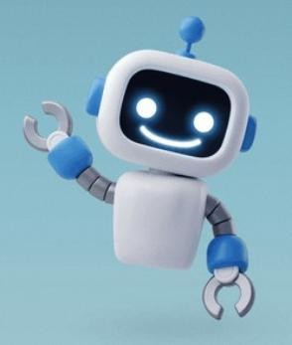
INDEX -
What is a CHATBOT ?
Introduction to CHATBOT
History of CHATBOT
System requirements
How does it work
Types of CHATBOT
Architecture CHATBOT
Applications
Conclusion
Reference

Slide 3
WHAT IS A CHATBOT ?
A chatbot is a computer program that simulates human conversation with an end user. Though not all chatbots are equipped with artificial intelligence (AI), modern chatbots increasingly use conversational AI techniques like natural language processing (NLP) to understand the user’s questions and automate responses to them.
At a technical level, a chatbot is a computer program that simulates human conversation to solve customer queries. When a customer or a lead reaches out via any channel, the chatbot is there to welcome them and solve their problems. They can also help the customers lodge a service request, send an email or connect to human agents if need be.
If this reminds you of a telephonic customer care number where you choose the options according to your need, you would be very correct. That phone tree is also a chatbot, though a very primitive one. Modern chatbots do the same thing by holding a conversation with customers. This conversation may be in the form of text, voice or a hybrid of both.

Slide 4
WHAT IS A CHATBOT ?
At the most basic level, a chatbot is a computer program that simulates and processes human conversation (either written or spoken), allowing humans to interact with digital devices as if they were communicating with a real person. Chatbots can be as simple as rudimentary programs that answer a simple query with a single-line response, or as sophisticated as digital assistants that learn and evolve to deliver increasing levels of personalization as they gather and process information.

Slide 5
INTRODUCTION TO CHATBOT
Chatbots are not a recent devment. They are simulations that can understand human language, process it, and interact back with humans while performing specific tasks. For example, a chatbot can be employed as a helpdesk executive. Joseph Weizenbaum created the first chatbot in 1966, named Eliza. It all started when Alan Turing published an article named “Computer Machinery and Intelligence” and raised an intriguing question, “Can machines think?” ever since, we have seen multiple chatbots surpassing their predecessors to be more naturally conversant and technologically advanced. These advancements have led us to an era where conversations with chatbots have become as normal and natural as with another human. Before looking into the AI chatbot, learn the foundations of artificial intelligence.
Check out the detailed eligibility requirements for the different AI courses offered by Great Learning
Today, almost all companies have chatbots to engage their users and serve customers by catering to their queries. We practically will have chatbots everywhere, but this doesn’t necessarily mean that all will be well-functioning. The challenge here is not to develop a chatbot but to develop a well-functioning one.

Slide 6
HISTORY OF CHATBOT
The first chatbot ever was developed by MIT professor Joseph Weizenbaum in the 1960s. It was called ELIZA. You’ll read more about ELIZA and other popular chatbots that were developed in the second half of the 20th century later on.
In the year 2009, a company called WeChat in China created a more advanced Chatbot. Since its launch, WeChat has conquered the hearts of many users who demonstrate an unwavering loyalty to it. It is a highly thriving social media platform.
Though it has implications and is less performant than today’s messaging apps such as Facebook Messenger, Slack, and Telegram, it doesn’t mean that you cannot construct a very smart bot on WeChat.
Early in 2016, we saw the intro of the first wave of artificial data
technology in the design of chatbots.

Slide 7
SYSTEM REQUIREMENTS
1.Hardware Requirements
*Processor -intel pentium or higher
*RAM-minimum->4GB Maximum ->6GB
2.software requirements
*Front end-OS -windows 7,8,10
*Back end-Python must be installed
3.Python IDE (Jetbrains Pychram)

Slide 8
HOW DOES IT WORK
The code starts by importing necessary libraries, including nltk for natural language processing and Chat and reflections from nltk.chat.util.The NLTK library requires language resources for tasks like tokenization. The code downloads the 'punkt' resource to enable text tokenization.Conversation pairs are defined to establish patterns for user input and corresponding bot responses. Each pair consists of a user input pattern (expressed as a regular expression or a specific phrase) and a list of possible responses.
Chat class from NLTK is utilized.to initialize the chatbot with the defined conversation pairs and reflections.he code enters a while loop, prompting the user to input queries. The chatbot processes the input, generates a response based on the predefined pairs, and displays the response.
The code is designed to be easily customizable. Additional conversation pairs can be added or existing ones modified to tailor the chatbot’s behavior to specific business needs.
Throughout the interaction, the chatbot maintains a polite and helpful tone, contributing to a positive user experiences

Slide 9
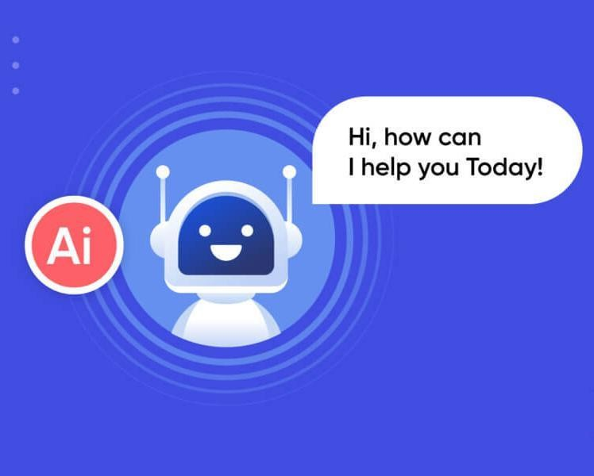
TYPES OF CHATBOT
Rule based chatbots
AI-powered chatbots
Virtual Assistants
Transactional Chatbot
Informational Chatbots
Entertainment Chatbot
Language Understanding (LU) Chatbots
Hybrid Chatbots
Scripted Chatbots
Social Media Chatbots
Voice-Enabled Chatbots
Context-Aware Chatbots

Slide 10
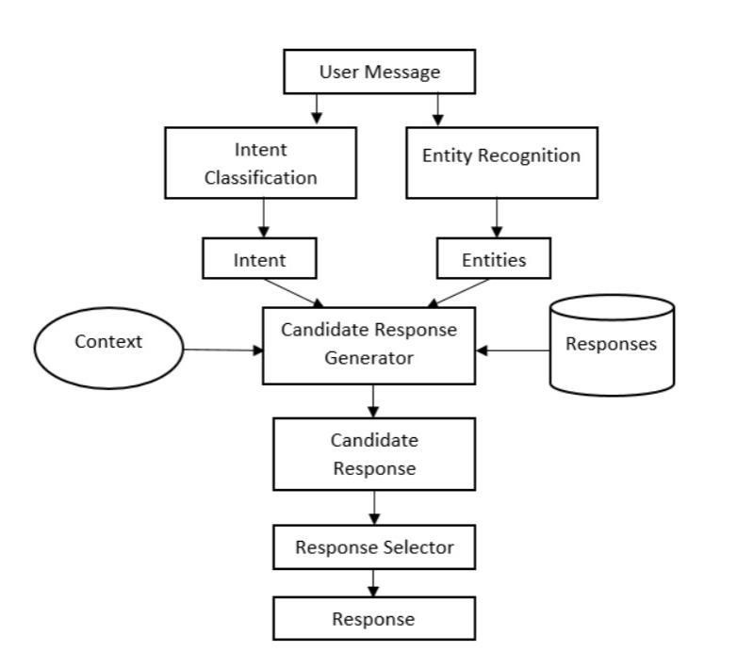
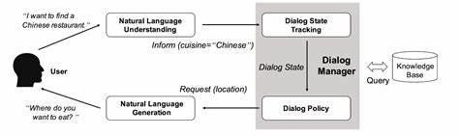
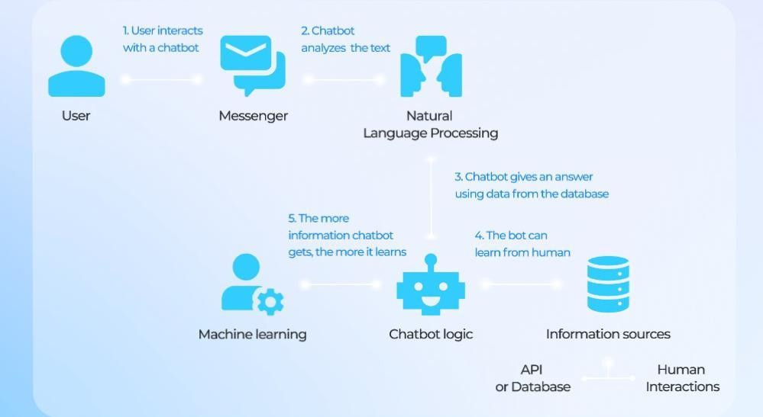
ARCHITECTURE CHATBOT

Slide 11

APPLICATIONS
Customer Service
E-commerce
Healthcare
Finance
Education
Human resources
Travel & Hospitality
Marketing & Sales
Internal communication
Entertainment
Healthcare information
Survey & Feedback
Smaethome control

Slide 12
CONCLUSION
In conclusion, chatbots have revolutionized the way businesses engage with users, providing seamless and instant interactions. With their 24/7 availability and ability to handle repetitive tasks, chatbots enhance customer service, offering timely responses and freeing up human resources. Their cost efficiency and scalability make them invaluable in various sectors, from customer support to healthcare, finance, and beyond. While chatbots excel in routine tasks, there are challenges such as the need for ongoing improvement and potential limitations in understanding complex queries. Striking a balance between automation and human touch remains crucial for optimal user experiences. As technology advances, chatbots are poised to play an increasingly vital role in shaping how organizations connect with their audiences, delivering consistent messaging, and collecting valuable data for continuous improvement. In the dynamic landscape of artificial intelligence, chatbots stand as versatile tools, contributing to efficiency, convenience, and improved customer satisfaction in diverse industries.

Slide 13
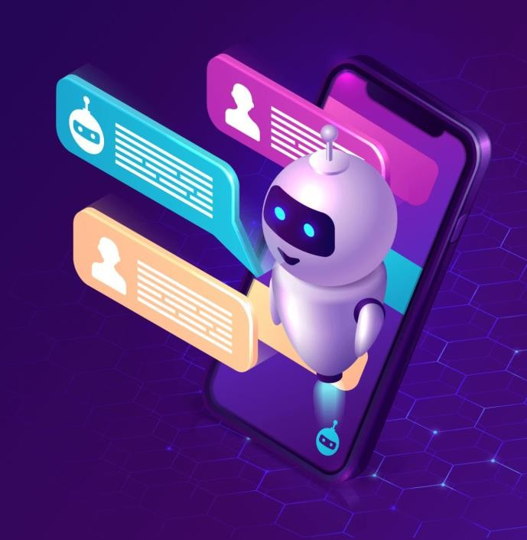
REFERENCE
https://www.chatbot.com/
https://cloud.google.com/use-cases/ai-chatbot/
https://zapier.com/blog/best-ai-chatbot/
https://www.ibm.com/topics/chatbots/
https://www.tidio.com/blog/ai-chatbot/

Slide 14
PROGRAM
import nltk
from nltk.chat.util import Chat, reflections
nltk.download(‘punkt’)
pairs = [
[“hello|hi|hey”, [“Hi there! How can I help you today?”, “Hello!”]],
[r”(.*)problem(.*)”, [“Could you please specify the problem area (e.g., order status, payment method)?”]],
[“How can I return a product?”, [“To initiate a return, please visit our ‘Returns’ page on the website or contact our support team for assistance.”]],
[“I received a damaged product”, [“I apologize for the inconvenience. Please provide your order number, and we will arrange for a replacement or
refund.”]],
[“Tell me about your shipping options”, [“We offer standard and express shipping. The delivery time and cost depend on your location. You can find more
details on our ‘Shipping’ page.”]],
[“What is the status of my refund?”, [“To check the status of your refund, please provide the reference number or the email associated with your order.”]],
[“Can I change my shipping address?”, [“Certainly! Please contact our support team as soon as possible with the updated shipping address.”]],
[“I can’t log in to my account”, [“If you’re having trouble logging in, you can use the ‘Forgot Password’ link on the login page or contact support for
assistance.”]],
[“Tell me about your loyalty program”, [“Our loyalty program offers exclusive rewards and discounts. You can find more information on our website or
contact support for details.”]],

Slide 15
PROGRAM
[“I have a suggestion”, [“We appreciate your feedback! Please share your suggestion, and we’ll consider it for future improvements.”]],
[“How can I check the warranty status?”, [“To check the warranty status of your product, provide the serial number, and we’ll provide you with the relevant
information.”]],
[“Can I change my order after placing it?”, [“To make changes to your order, please reach out to our support team within a few hours of placing the
order.”]],
[“I’m having trouble applying a discount code”, [“Ensure that the discount code is entered correctly and is still valid. If the issue persists, contact our support
team for assistance.”]],
[“What security measures do you have for online transactions?”, [“We use encryption and secure protocols to ensure the safety of your online transactions.
Your security is our priority.”]],
[“Can you recommend product alternatives?”, [“Certainly! Please specify the type of product you’re looking for, and we’ll suggest some alternatives from
our catalog.”]],
[“order status”, [“Your order is currently being processed.”]],
[“payment issue”, [“Please contact our support team at support@example.com for assistance with payment issues.”]],
[“goodbye”, [“Goodbye! Have a great day.”]],
[“How can I contact customer support?”, [“You can contact our support team via email at support@example.com or by phone at 123-456-7890.”]],
[“What are your business hours?”, [“Our business hours are from 9 AM to 5 PM, Monday to Friday.”]],

Slide 16
PROGRAM
[“Can you help me track my order?”, [“Certainly! To track your order, please provide your order number.”]],
[“What is your return policy?”, [“Our return policy allows returns within 30 days of purchase. Please check our website for detailed information.”]],
[“How do I reset my password?”, [“You can reset your password by clicking on the ‘Forgot Password’ link on the login page.”]],
[“What payment methods do you accept?”, [“We accept credit cards (Visa, MasterCard, American Express) and PayPal.”]],
[“Is there a warranty for the products?”, [“Yes, our products come with a standard one-year warranty. Please check the product documentation for
details.”]],
[“How do I cancel or modify my order?”, [“To cancel or modify your order, please contact our support team as soon as possible.”]],
[“Do you offer discounts or promotions?”, [“Yes, we regularly have promotions and discounts. Check our website or subscribe to our newsletter for
updates.”]],
[“Can you provide technical support for your products?”, [“Certainly! Please describe the technical issue you are facing, and we’ll do our best to assist you.”]],
[“How do I apply a discount code during checkout?”, [“During checkout, you can enter the discount code in the designated field before completing your
purchase.”]],
[“Can you recommend accessories for my product?”, [“Certainly! Please provide the name or model of your product, and we can suggest compatible
accessories.”]],
[“How do I check the status of a repair or service request?”, [“To check the status of a repair or service request, please provide the reference number, and
we’ll provide you with an update.”]],

Slide 17
PROGRAM
[“Can you help me track my order?”, [“Certainly! To track your order, please provide your order number.”]],
[“What is your return policy?”, [“Our return policy allows returns within 30 days of purchase. Please check our website for detailed information.”]],
[“How do I reset my password?”, [“You can reset your password by clicking on the ‘Forgot Password’ link on the login page.”]],
[“What payment methods do you accept?”, [“We accept credit cards (Visa, MasterCard, American Express) and PayPal.”]],
[“Is there a warranty for the products?”, [“Yes, our products come with a standard one-year warranty. Please check the product documentation for
details.”]],
[“How do I cancel or modify my order?”, [“To cancel or modify your order, please contact our support team as soon as possible.”]],
[“Do you offer discounts or promotions?”, [“Yes, we regularly have promotions and discounts. Check our website or subscribe to our newsletter for
updates.”]],
[“Can you provide technical support for your products?”, [“Certainly! Please describe the technical issue you are facing, and we’ll do our best to assist you.”]],
[“How do I apply a discount code during checkout?”, [“During checkout, you can enter the discount code in the designated field before completing your
purchase.”]],
[“Can you recommend accessories for my product?”, [“Certainly! Please provide the name or model of your product, and we can suggest compatible
accessories.”]],
[“How do I check the status of a repair or service request?”, [“To check the status of a repair or service request, please provide the reference number, and
we’ll provide you with an update.”]],

Slide 18
PROGRAM
[“I have a complaint”, [“I’m sorry to hear that. Please share the details of your complaint, and we’ll do our best to address and resolve the issue.”]],
[“Tell me about your product testing process”, [“Our products undergo rigorous testing to ensure quality and safety. We prioritize delivering reliable
products that meet the highest standards.”]],
[“How can I provide feedback on your website?”, [“We appreciate your feedback! You can submit your feedback through the ‘Contact Us’ page on our website. Thank you for helping us improve!”]],
[“Can I change the color/size of my ordered item?”, [“To change the color or size of your ordered item, contact our support team, and they will assist you
with the necessary steps.”]],
[“I’m having trouble with the website”, [“If you’re experiencing technical issues with the website, try clearing your browser cache. If the problem persists,
contact our support team for further assistance.”]],
[“Tell me about your environmentally friendly initiatives”, [“We are committed to sustainability and have various initiatives, such as using eco-friendly
materials and reducing our carbon footprint. Visit our website for more details.”]],
[“Do you offer international shipping?”, [“Yes, we offer international shipping. The shipping cost and delivery time vary by location. Check our ‘Shipping’ page for more information.”]],
[“How can I join your affiliate program?”, [“To join our affiliate program, visit the ‘Affiliates’ section on our website and follow the registration process.
Start earning commissions for promoting our products!”]],
[“I want to change my email address”, [“To update your email address, log in to your account and navigate to the ‘Account Settings’ page. Update your email, and the changes will take effect immediately.”]],

Slide 19
PROGRAM
.[“Tell me about your product reviews”, [“We encourage customers to leave product reviews on our website. Your feedback helps other customers make
informed decisions about our products. Thank you for sharing your experiences!”]],
[“What safety measures do you have in place for in-store shopping?”, [“In our physical stores, we have implemented safety measures such as social
distancing, sanitization, and mask requirements to ensure a secure shopping environment.”]],
[“(.*)”, [“I’m sorry, I didn’t understand that. How may I assist you?”]]
def customer_support_chatbot():
print(“Welcome to Customer Support Chatbot. Type ‘goodbye’ to exit.”)
chat = Chat(pairs, reflections)
while True:
•
•
•
•
•
•
if name == “main”:
customer_support_chatbot()
user_input = input(“You: “).lower()
if user_input == “goodbye”:
print(chat.respond(user_input))
break
response = chat.respond(user_input)
print(“Bot:”, response)

Slide 20


